Slide 1

Object Oriented Software Engineering
UML
Lecture 2

Slide 2
Today’s Outline:
Overview of UML
UML Building Blocks
Things
Relationships
Diagrams

Slide 3
3. Overview of UML
3.0 Objectives
3.1 Introduction
3.2 Things
3.2.1 Structural Things
3.2.2 Behavioral Things
3.2.3 Grouping Things
3.2.4 Annotational Things
3.3 Relationships
3.3.1 Dependency
3.3.2 Association
3.3.3 Generalization
3.3.4 Realization
3.4 Diagrams
3.4.1 Structure Diagrams
3.4.2 Behaviour Diagrams
3.4.3 Interaction Diagrams

Slide 4
UML Building Blocks
UML is composed of three main building blocks, i.e., things, relationships, and diagrams. Building blocks generate one complete UML model diagram by rotating around several different blocks. It plays an essential role in developing UML diagrams. The basic UML building blocks are enlisted below:
Things
Relationships
Diagrams

Slide 5
3.0 OBJECTIVES
To understand the building blocks of UML
▫ Things and its four types
▫ Relationships and its four types
▫ Diagrams and its three types.

Slide 6
3.1 INTRODUCTION
UML is constructed from three main building blocks: things, relationships and diagrams. When these building blocks are understood correctly it is easy to use the UML.

Slide 7
3.2 THINGS
Anything that is a real world entity or object is termed as things. It can be divided into several different categories:
There are four types of things in the UML. These are
Structural,
Behavioral,
Grouping,
Annotational

Slide 8
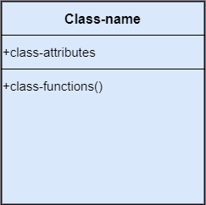
3.2.1. Structural Things
A. Structural Things
Nouns that depicts the static behavior of a model is termed as structural things. They display the physical and conceptual components. They include class, object, interface, node, collaboration, component, and a use case.
i. Class: A Class is a set of identical
things that outlines the functionality
and properties of an object. It also
represents the abstract class whose
functionalities are not defined. Its
notation is as follows;

Slide 9
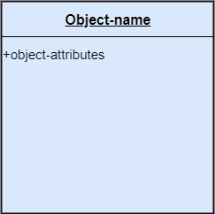
3.2.1. Structural Things
ii. Object: An individual that describes
the behavior and the functions of a
system. The notation of the object
is similar to that of the class; the
only difference is that the object
name is always underlined and
its notation is given below;

Slide 10
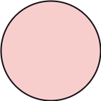
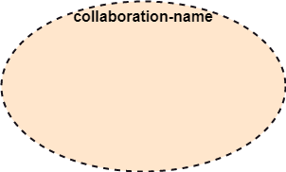
3.2.1. Structural Things
iii. Interface: A set of operations that describes the functionality of a class, which is implemented whenever an interface is implemented.
iv. Collaboration:
It represents the interaction between things that is done to meet the goal. It is symbolized as a dotted
ellipse with its name written inside it.

Slide 11
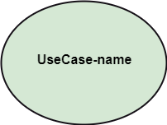
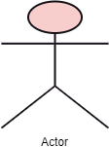
3.2.1. Structural Things
iv. Use case: Use case is the core concept of object-oriented modeling. It portrays a set of actions executed by a system to achieve the goal.
v. Actor:
It comes under the use case
diagrams. It is an object that interacts
with the system, for example, a user.

Slide 12
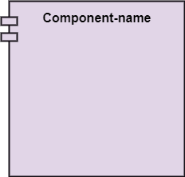
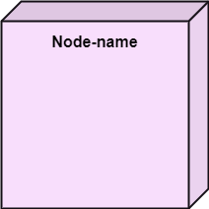
3.2.1. Structural Things
vi. Component:
It represents the physical part
of the system.
vii. Node:
A physical element that exists at run time..

Slide 13

3.2.2. Behavioral Things
They are the verbs that encompass the dynamic parts of a model. It depicts the behavior of a system. They involve state machine, activity diagram, interaction diagram, grouping things, annotation things.
State machine – state machine is useful when the state of an object in its lifecycle is important. It defines the sequence of states an object goes through in response to events. Events are external factors responsible for state change

Slide 14

3.2.2. Behavioral Things
Interaction – some behavior constituted by messages
exchanged among objects. The exchange of messages
is with a view to achieving some purpose.

Slide 15
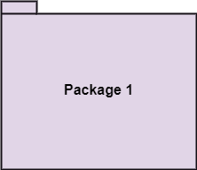
3.2.3. Grouping Things
i. Package:
It is a method that together
binds the elements of the
UML model. In UML, the
package is the only thing,
which is used for grouping.
Package: Package is the only
thing that is available for
grouping behavioral and
structural things.

Slide 16
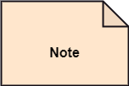
3.2.4. Annotation Things
It is a mechanism that captures the remarks, descriptions, and comments of UML model elements. In UML, a note is the only Annotational thing.
Note:
It is used to attach the constraints, comments, and rules to the elements of the model. It is a kind of yellow sticky note.

Slide 17
3.3. Relationships
It illustrates the meaningful connections between things. It shows the association between the entities and defines the functionality of an application. There are four types of relationships given below:
i. Dependency: Dependency is a kind of relationship in which a change in target element affects the source element, or simply we can say the source element is dependent on the target element. It is one of the most important notations in UML. It depicts the dependency from one entity to another.
It is denoted by a dotted line followed by an arrow at one side as shown below,

Slide 18
3.3. Relationships
ii. Association:
A set of links that associates the entities to the UML model. It tells how many elements are actually taking part in forming that relationship.
It is denoted by a dotted line with arrowheads on both sides to describe the relationship with the element on both sides.

Slide 19


3.3. Relationships
iii. Generalization: It portrays the relationship between a general thing (a parent class or superclass) and a specific kind of that thing (a child class or subclass). It is used to describe the concept of inheritance.
iv. Realization: It is a semantic kind of relationship between two things, where one defines the behavior to be carried out, and the other one implements the mentioned behavior. It exists in interfaces.
It is denoted by a dotted line with an empty arrowhead at one side.

Slide 20
3.4. Diagram
The diagrams are the graphical implementation of the models that incorporate symbols and text. Each symbol has a different meaning in the context of the UML diagram. There are thirteen different types of UML diagrams that are available in UML 2.0, such that each diagram has its own set of a symbol. And each diagram manifests a different dimension, perspective, and view of the system.
UML diagrams are classified into three categories that are given below:
Structural Diagram
Behavioral Diagram
Interaction Diagram

Slide 21
Structural Diagram
i. Structural Diagram:
It represents the static view of a system by portraying the structure of a system. It shows several objects residing in the system. Following are the structural diagrams given below:
Class diagram
Object diagram
Package diagram
Component diagram
Deployment diagram

Slide 22
Behavioral Diagram
ii. Behavioral Diagram: It depicts the behavioral features of a system. It deals with dynamic parts of the system. It encompasses the following diagrams:
Activity diagram
State machine diagram
Use case diagram
iii. Interaction diagram: It is a subset of behavioral diagrams. It depicts the interaction between two objects and the data flow between them. Following are the several interaction diagrams in UML:
Timing diagram
Sequence diagram
Collaboration diagram

Slide 23
UML- Architecture
Software architecture is all about how a software system is built at its highest level. It is needed to think big from multiple perspectives with quality and design in mind. The software team is tied to many practical concerns, such as:
The structure of the development team.
The needs of the business.
Development cycle.
The intent of the structure itself.

Slide 24
UML- Architecture
The architect plans the structure of the system to meet the needs like these. It is essential to have proper software architecture, mainly for a large software system. Having a clear design of a complete system as a starting point provides a solid basis for developers to follow.

Slide 25
UML- Architecture
The software architecture is useful to people such as software developers, the project manager, the client, and the end-user. Each one will have different perspectives to view the system and will bring different agendas to a project. Also, it provides a collection of several views. It can be best understood as a collection of five views:
Use case view
Design view
Implementation view
Process view
Development view

Slide 26
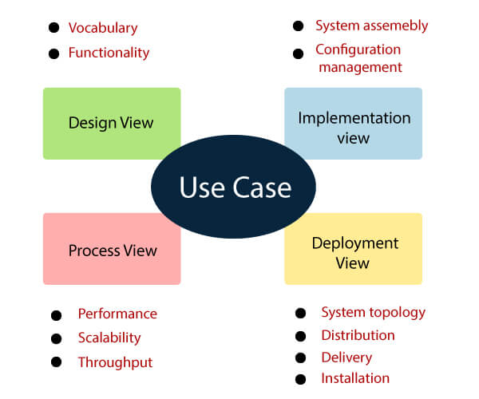
UML- Architecture

Slide 27
UML- Architecture
Use case view
It is a view that shows the functionality of the system as perceived by external actors.
It reveals the requirements of the system.
With UML, it is easy to capture the static aspects of this view in the use case diagrams, whereas it?s dynamic aspects are captured in interaction diagrams, state chart diagrams, and activity diagrams.
Design View
It is a view that shows how the functionality is designed inside the system in terms of static structure and dynamic behavior.
It captures the vocabulary of the problem space and solution space.
With UML, it represents the static aspects of this view in class and object diagrams, whereas its dynamic aspects are captured in interaction diagrams, state chart diagrams, and activity diagrams.

Slide 28
UML- Architecture
Implementation View:
It is the view that represents the organization of the core components and files.
It primarily addresses the configuration management of the system?s releases.
With UML, its static aspects are expressed in component diagrams, and the dynamic aspects are captured in interaction diagrams, state chart diagrams, and activity diagrams.
Process View:
It is the view that demonstrates the concurrency of the system.
It incorporates the threads and processes that make concurrent system and synchronized mechanisms.
It primarily addresses the system's scalability, throughput, and performance.
Its static and dynamic aspects are expressed the same way as the design view but focus more on the active classes that represent these threads and processes.

Slide 29
UML- Architecture
Deployment View
It is the view that shows the deployment of the system in terms of physical architecture.
It includes the nodes, which form the system hardware topology where the system will be executed.
It primarily addresses the distribution, delivery, and installation of the parts that build the physical system.

Slide 30
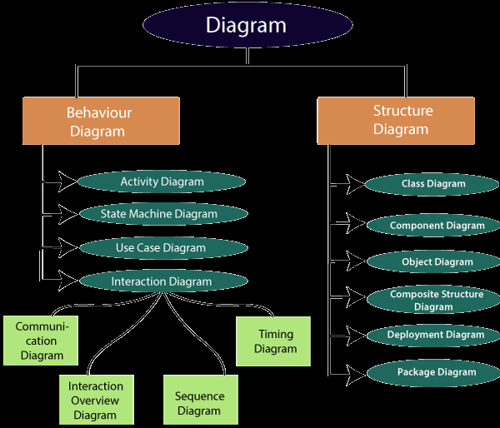
UML- Architecture

Slide 31
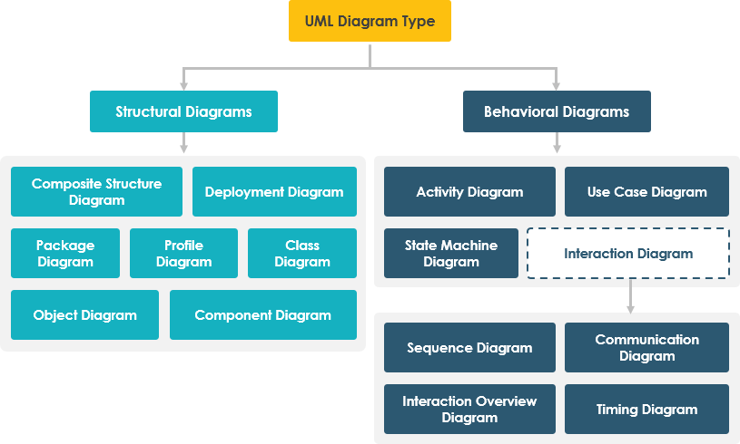
Types of UML

Slide 32
Thank You

